Slide 1
What is Mise-en-Scène?

Slide 2
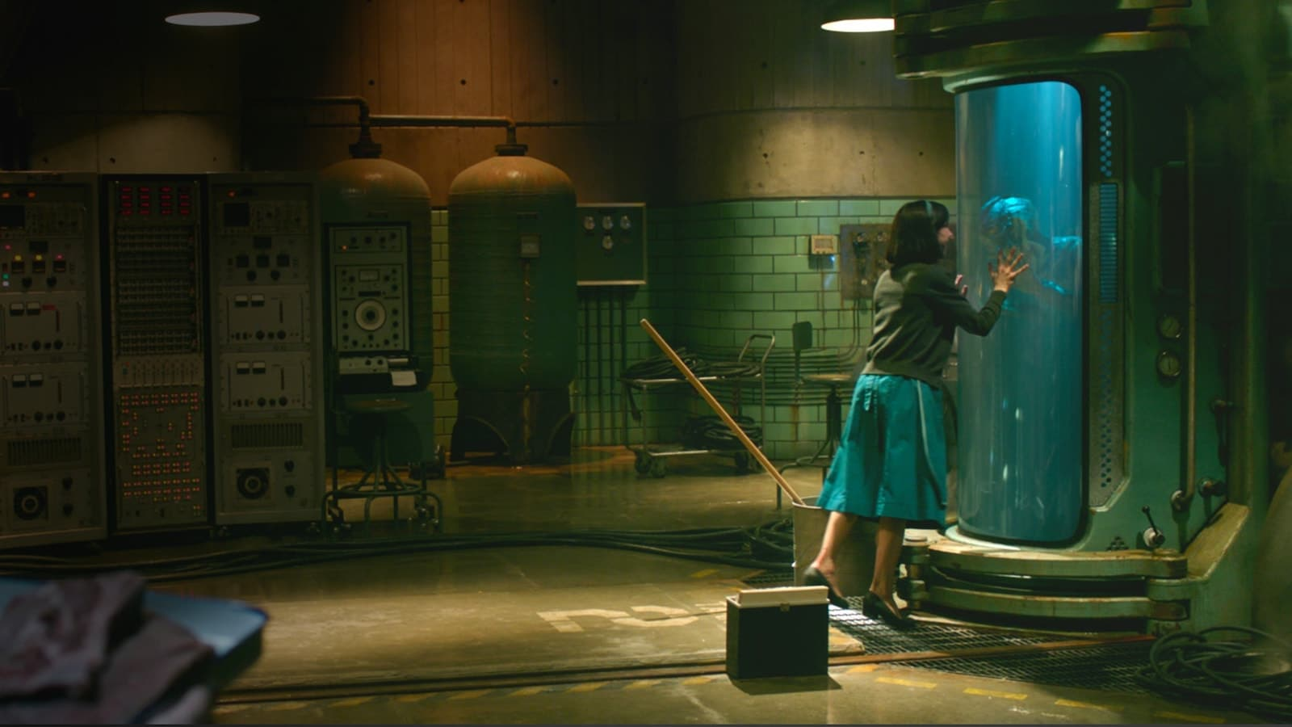
Definition
Mise-en-Scène – French for “putting in the scene”
Cinema – Everything that appears in front of the camera
Mise-en-Scène is often referred to as an unidentifiable quality of the cinema or theatre
Aspects of mise-en-scène are often confused with elements of the cinematography of a film and vice versa

Slide 3
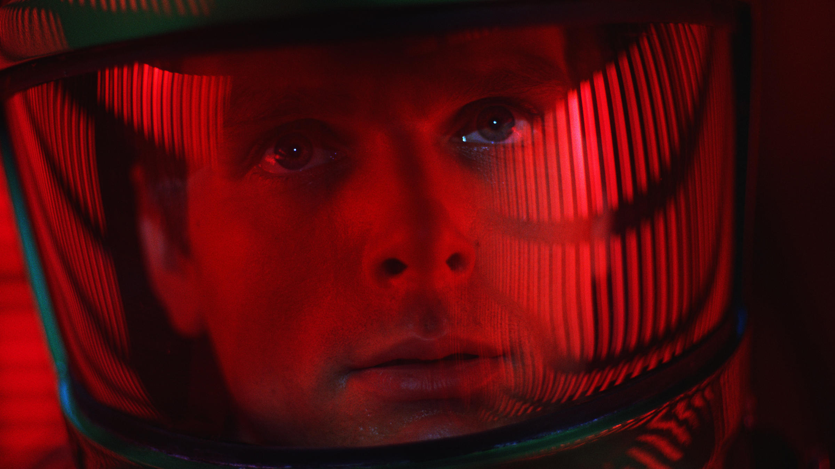
Mise-en-Scène affects…
The composition of a shot
The tone of a scene or the tone of a film by accumulation
The mood an audience has while watching the film
Larger themes of the film through visual motifs

Slide 4
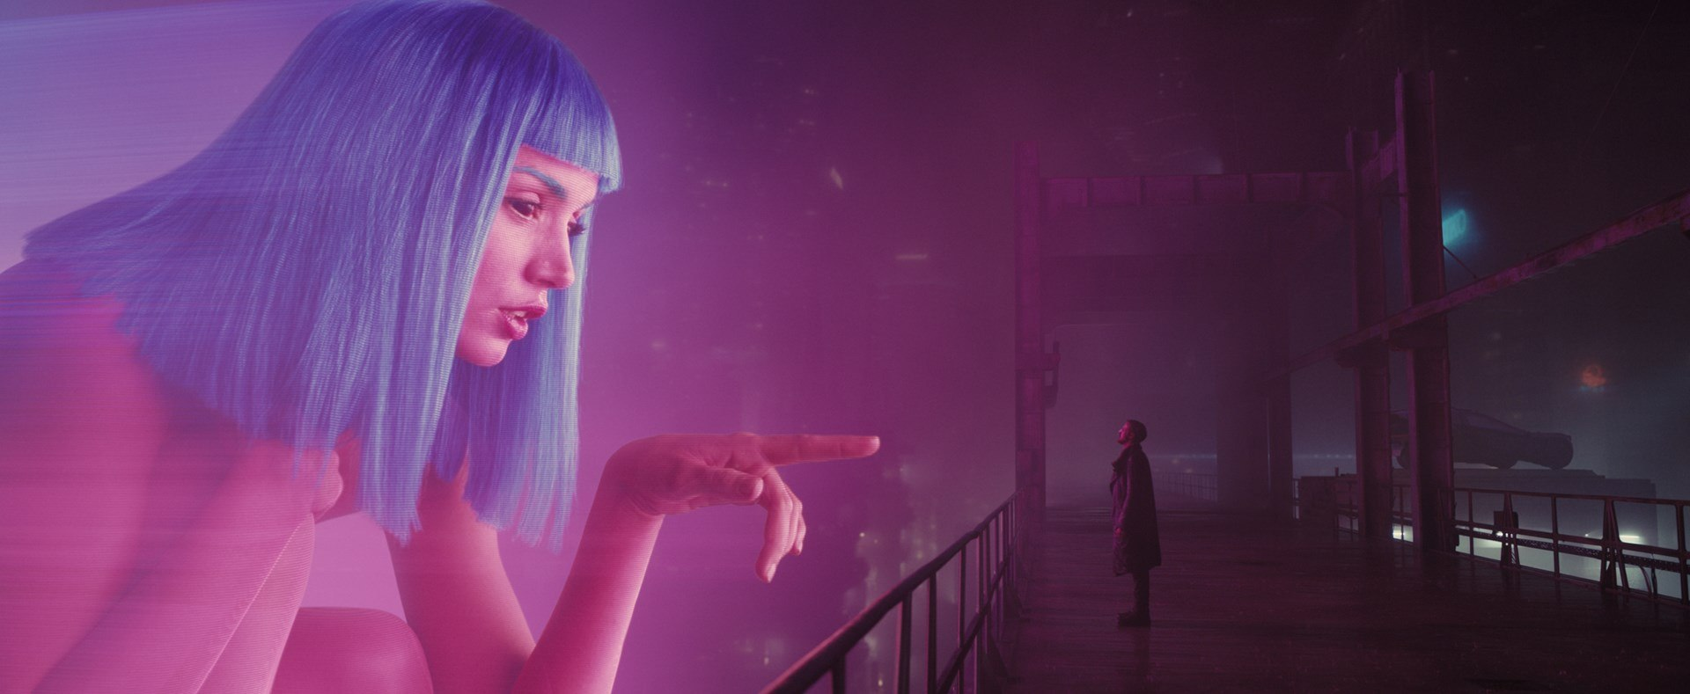
Mise-en-Scène and Cinematography DO Overlap
While color is an element of mise-en-scène, cinematographers are heavily involved in decisions regarding color in a film
The accumulation of cinematographic elements (a number of close-ups throughout a film or a scene, for instance) can affect the mise-en-scène
Lighting is a choice made by the cinematographer of a film that affects the mise-en-scène
For instance, high-key lighting makes characters and objects in the mise-en-scène appear to glow while low-key lighting makes them visually distinct from their surroundings
Spacing and character blocking are cinematographic choices that affect the mise-en-scène

Slide 5
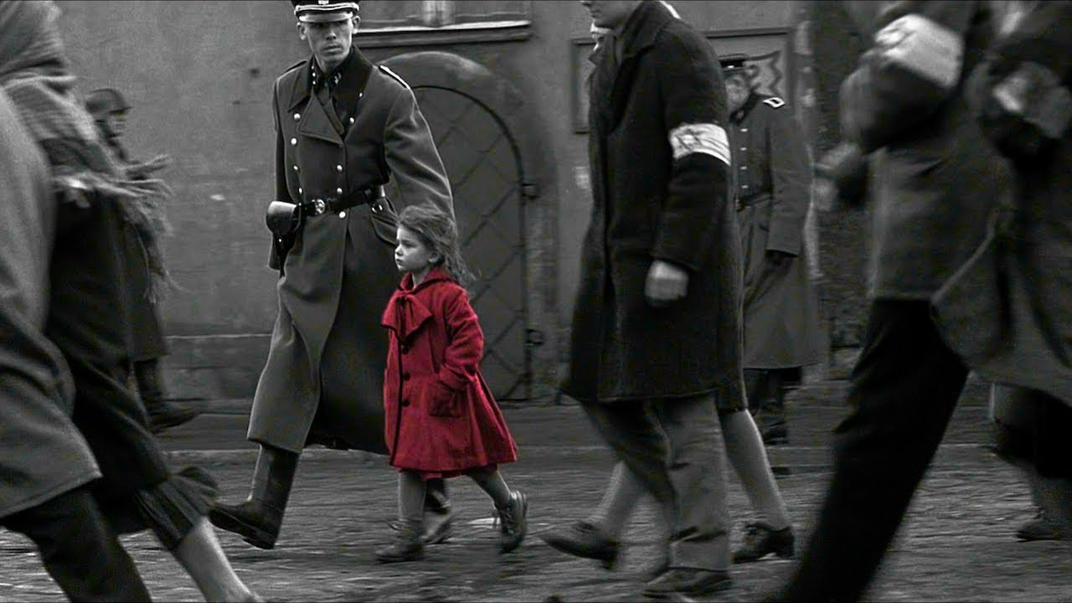
What is Décor?
The style of decoration of a room or setting
Relates more to “style” than other visual elements
Scenery or backdrop
Set design
Furnishings

Slide 6
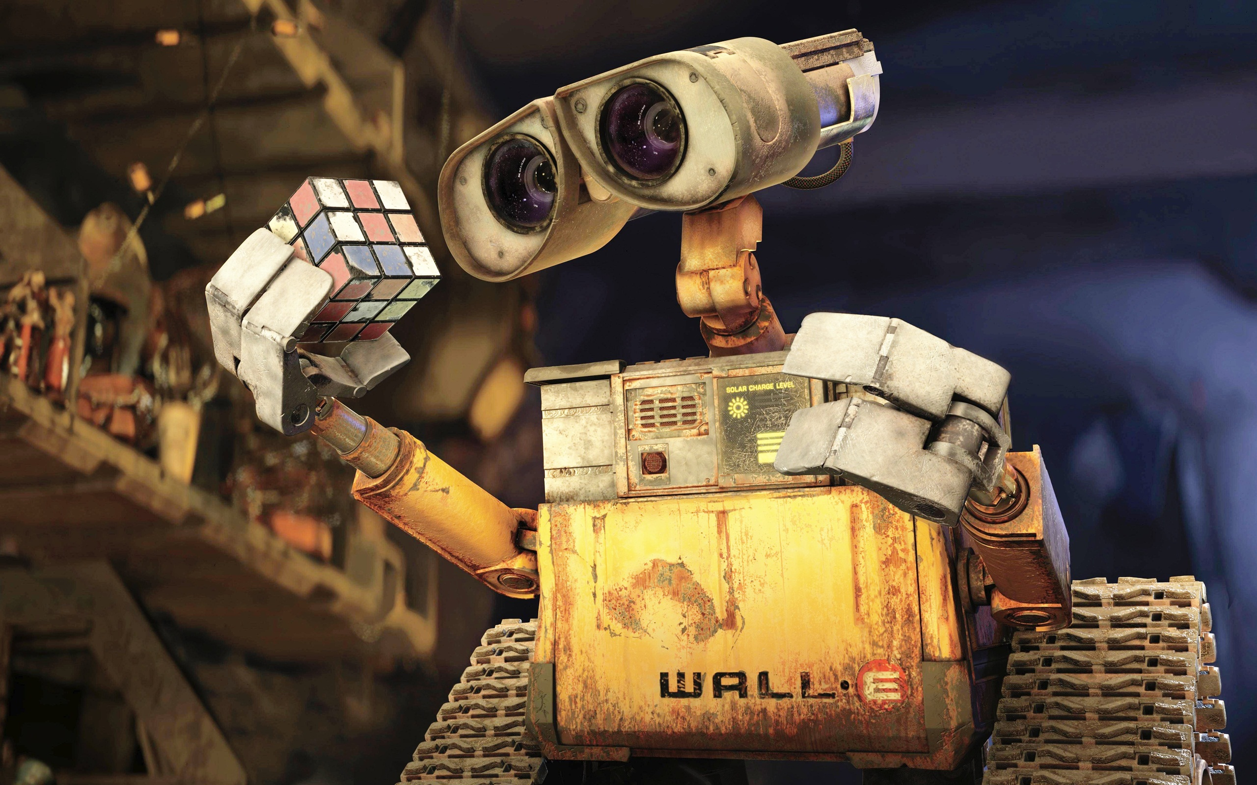
Other Elements of Mise-en-Scène
Set design and location vs. set shooting
Space
Costume design
Makeup and hairstyle design
Acting styles (silent film acting, black-and-white film acting, sound acting, color film acting)
Aspect ratio

Slide 7
Is this Mise-en-Scène?
A Brief Quiz!

Slide 8
Is this Mise-en-Scène?
The pacing of the shots in a fight sequence between two boxers

Slide 9
Is this Mise-en-Scène?
A green neon sign behind a curtain in an apartment makes the curtain glow slightly green in the background of a shot

Slide 10
Is this Mise-en-Scène?
A film features many cluttered and closed-frame shots, using props and character blocking to produce the effect

Slide 11
Is this Mise-en-Scène?
An actor is lauded for her excellent performance in a blockbuster film

Slide 12
Is this Mise-en-Scène?
A 2015 silent film with actors who perform expressively to convey emotions through gestures

Slide 13
Is this Mise-en-Scène?
A single shot of two people in conversation lasts for 90 seconds

Slide 14
Is this Mise-en-Scène?
The makeup and hairstyle team for a Victorian period film works to present actors in the Victorian fashion of the time

