Slide 1
Spirited Away
Miyazaki’s Masterpiece

Slide 2
Politicizing the Anime
Japanese isolationism, or Sakoku, was a period of 220 years (1633-1853) where relations and trade between Japan and other countries was severely limited
It was preceded by a period of widespread piracy and unrestricted trade
All foreign nationals were barred from entering Japan, and the Japanese commonfolk themselves were kept from leaving the country
The policies were enacted by the last feudal Japanese military government, the Tokugawa shogunate and only ended when the American Black Ships commanded by Matthew Perry forced the opening of Japanese trade through a series of unequal treaties
Well beyond this period, the Sakoku installed a cultural fear of integration with the world and openness to others; Japan still feels the effects of the Sakoku to this day, despite post WWII openness and tourism

Slide 3
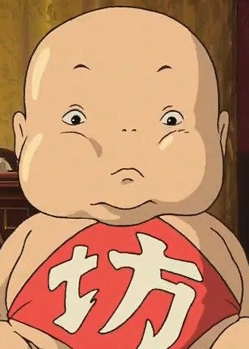
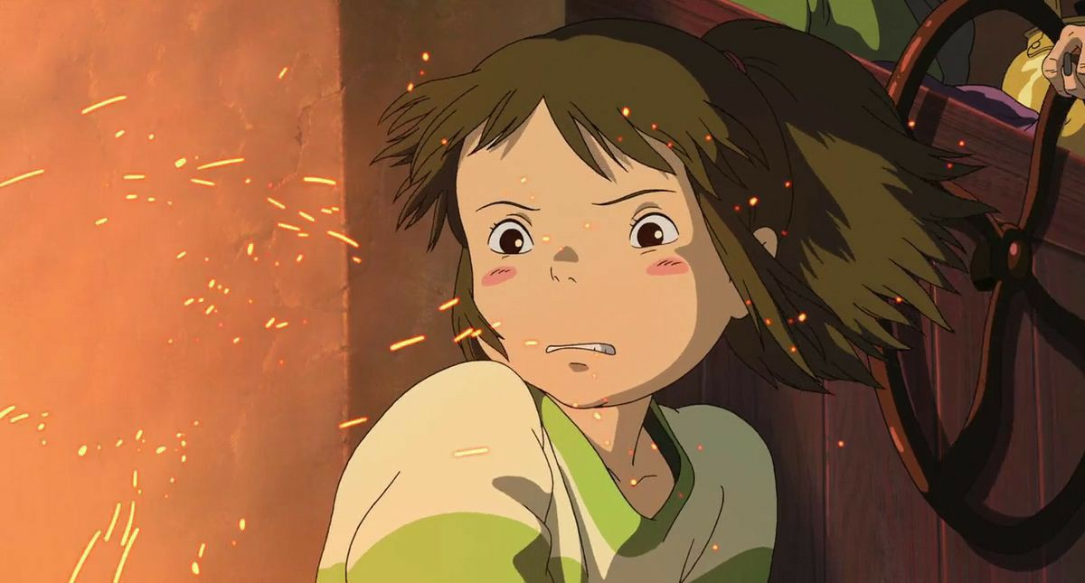
Politicizing the Anime
Japanese anxieties surrounding cultural integration can be seen throughout Spirited Away
Miyazaki depicts a nation torn between foreign notions of capitalism and consumerism and the puerile, phobic isolationism of the cultural other
Chihiro is at first a timid, phobic girl who needs a series of adult guides to help her (parents, Kamaji, Haku, Lin, Zeniba, etc.)
Chihiro shares much in common with Yubaba’s baby at the start of the film, as she clings to her mother in the tunnel, whines at every possible interval, and is taken aback by the array of cultural/physical Others she observes

Slide 4
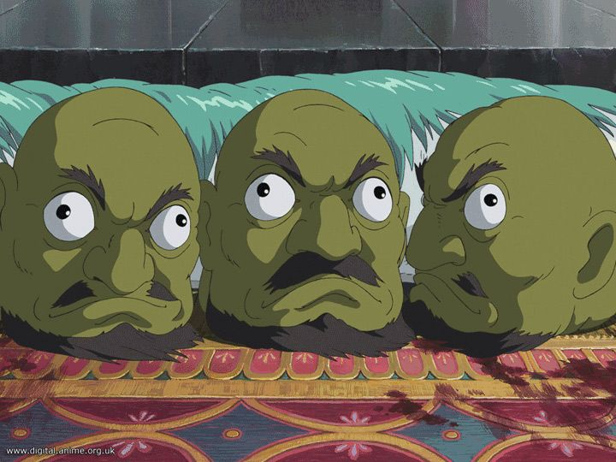
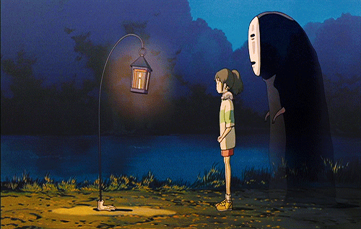
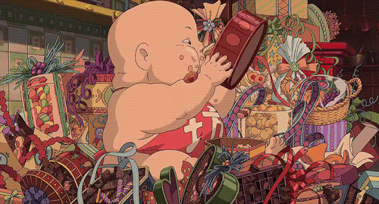
The Cultural/Physical Other
One character is composed of three disembodied green heads, one is a giant talking baby, and another is a lantern that is also a foot

Slide 5
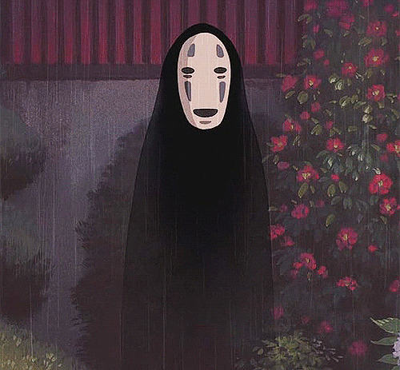
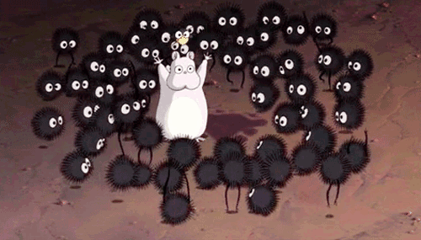
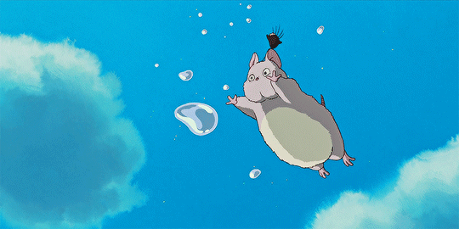
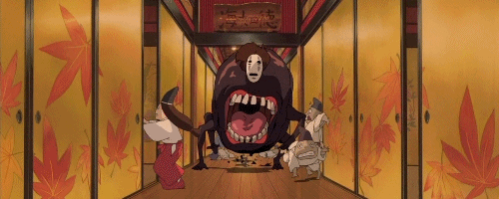

Slide 6
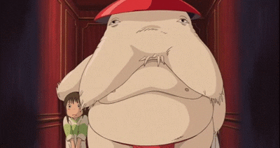
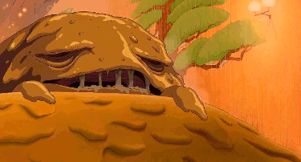
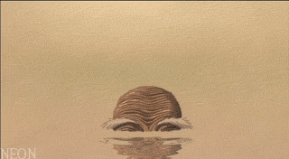
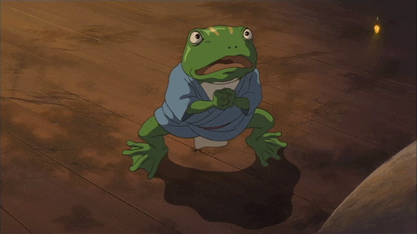
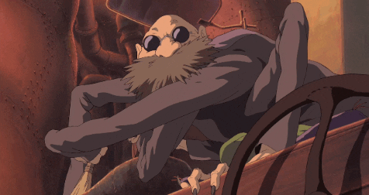

Slide 7
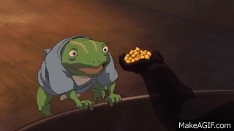
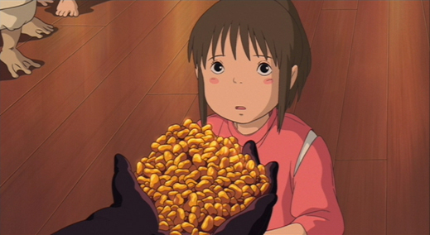
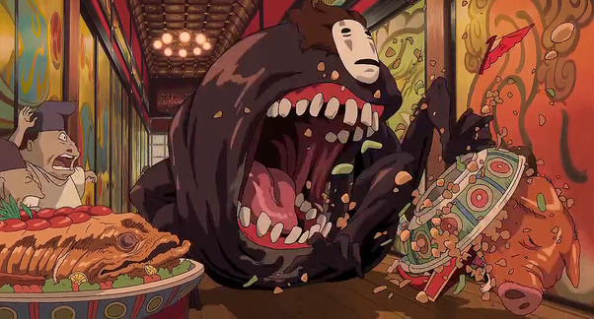
Capitalism and Consumerism

Slide 8
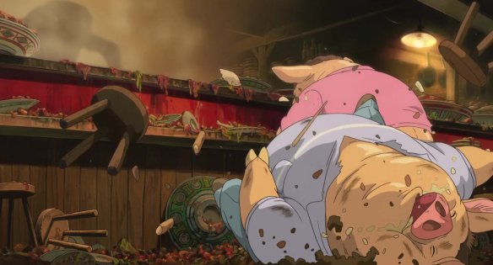
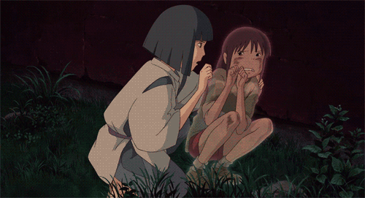
Capitalism and Consumerism

Slide 9
Cultural Pollutants
Images of Pollution

Slide 10
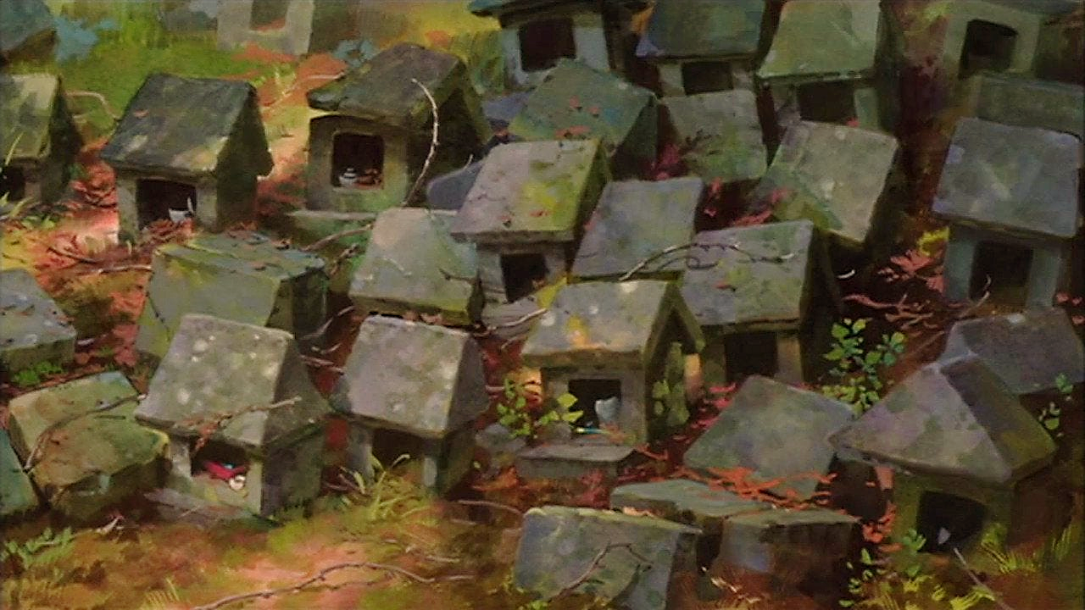

Slide 11
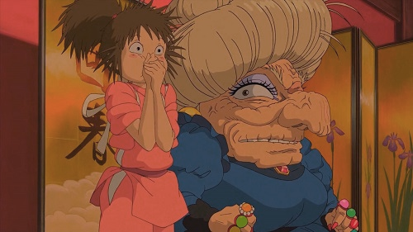
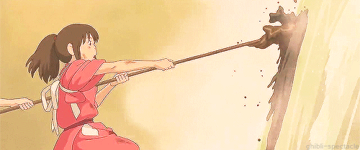
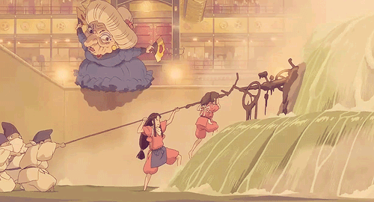
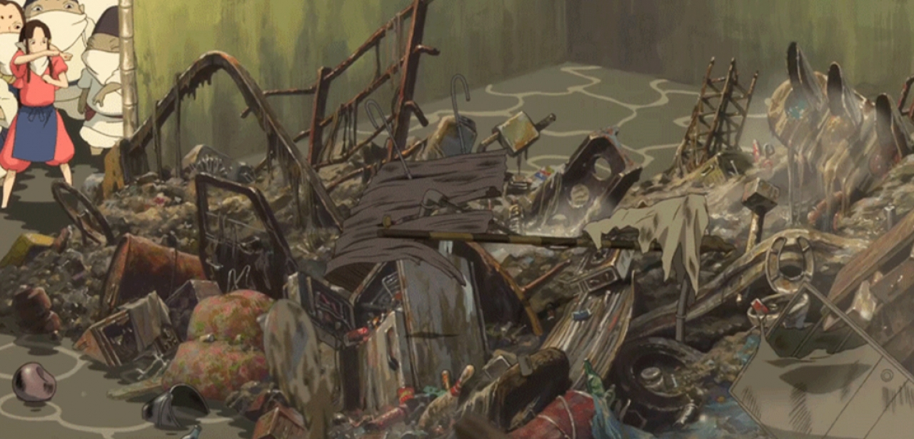

Slide 12
Taoist Dualism and Spirited Away
Two Sides to Every Story

Slide 13
Dualism
Taoism began as an indigenous Chinese religion
However, Taoism is believed to be the inspiration for spirituality in Japanese culture
Very similar to Shinto
A major concept in Taoism is the idea of duality
Everything has opposing sides from one another
Biological (boy/girl)
Physical (hot/cold)
Moral (good/bad)

Slide 14
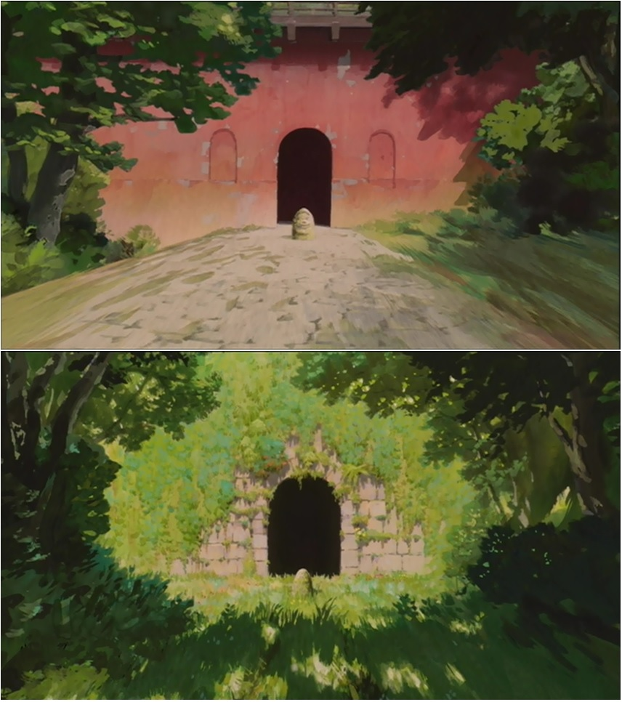
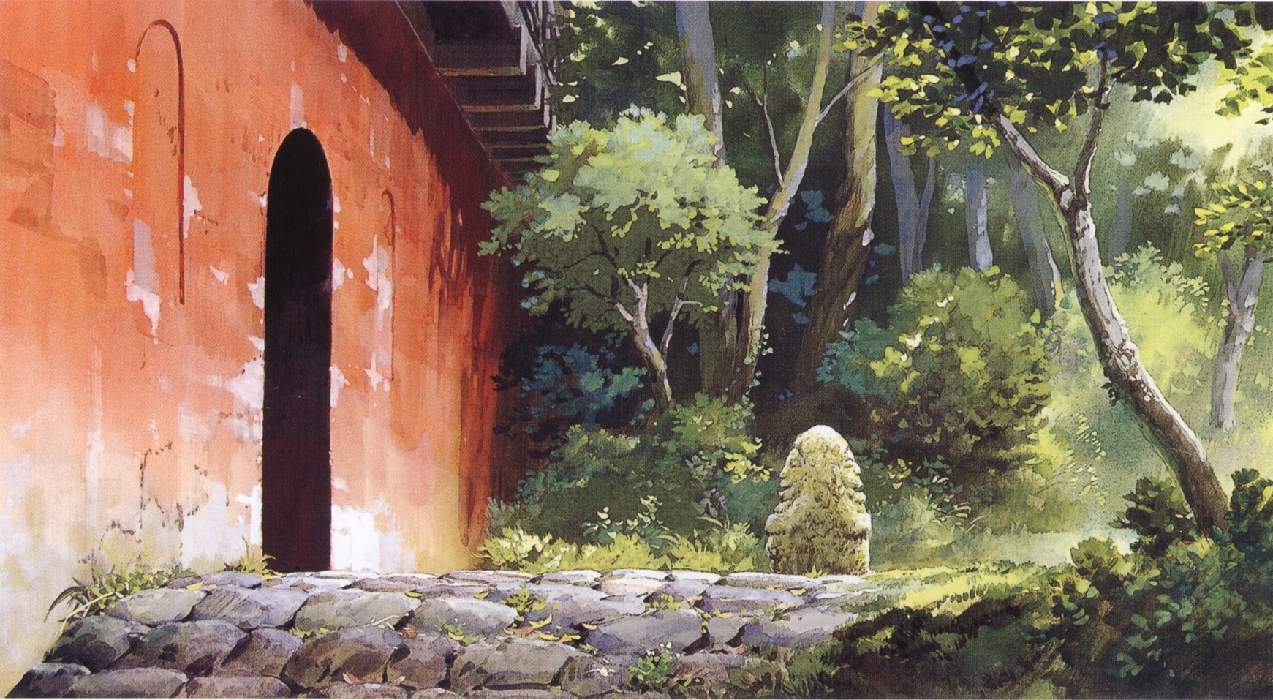

Slide 15
Dualism through Transformation
Creatures and Hybrids

Slide 16
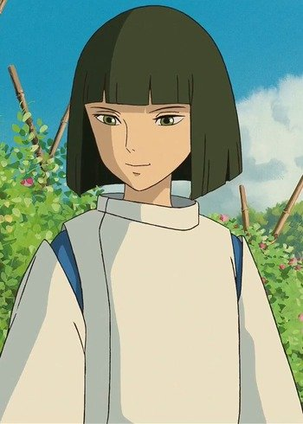
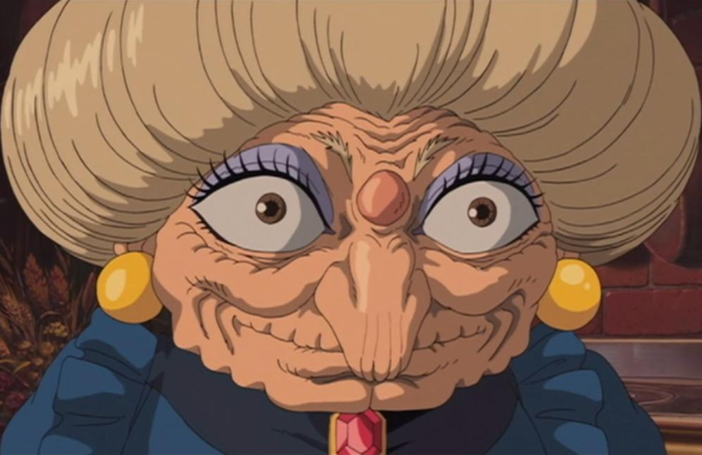
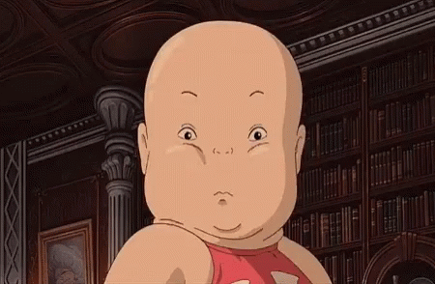
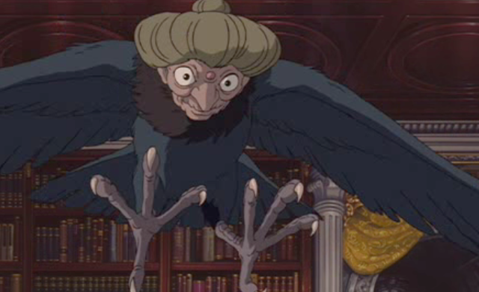
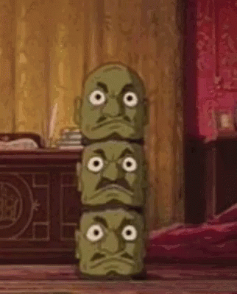
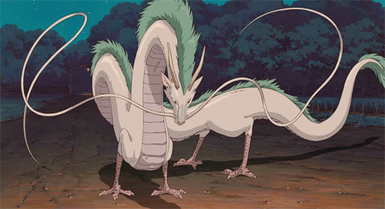

Slide 17
Dualism through Personality
Mercurial Characters

Slide 18
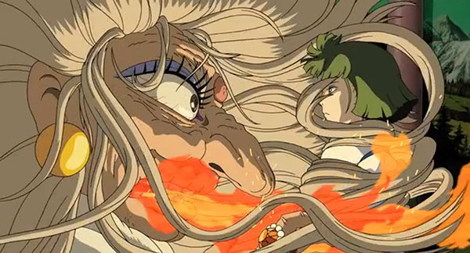
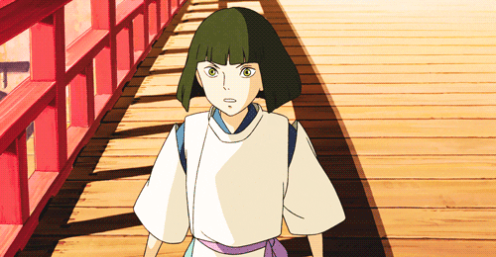
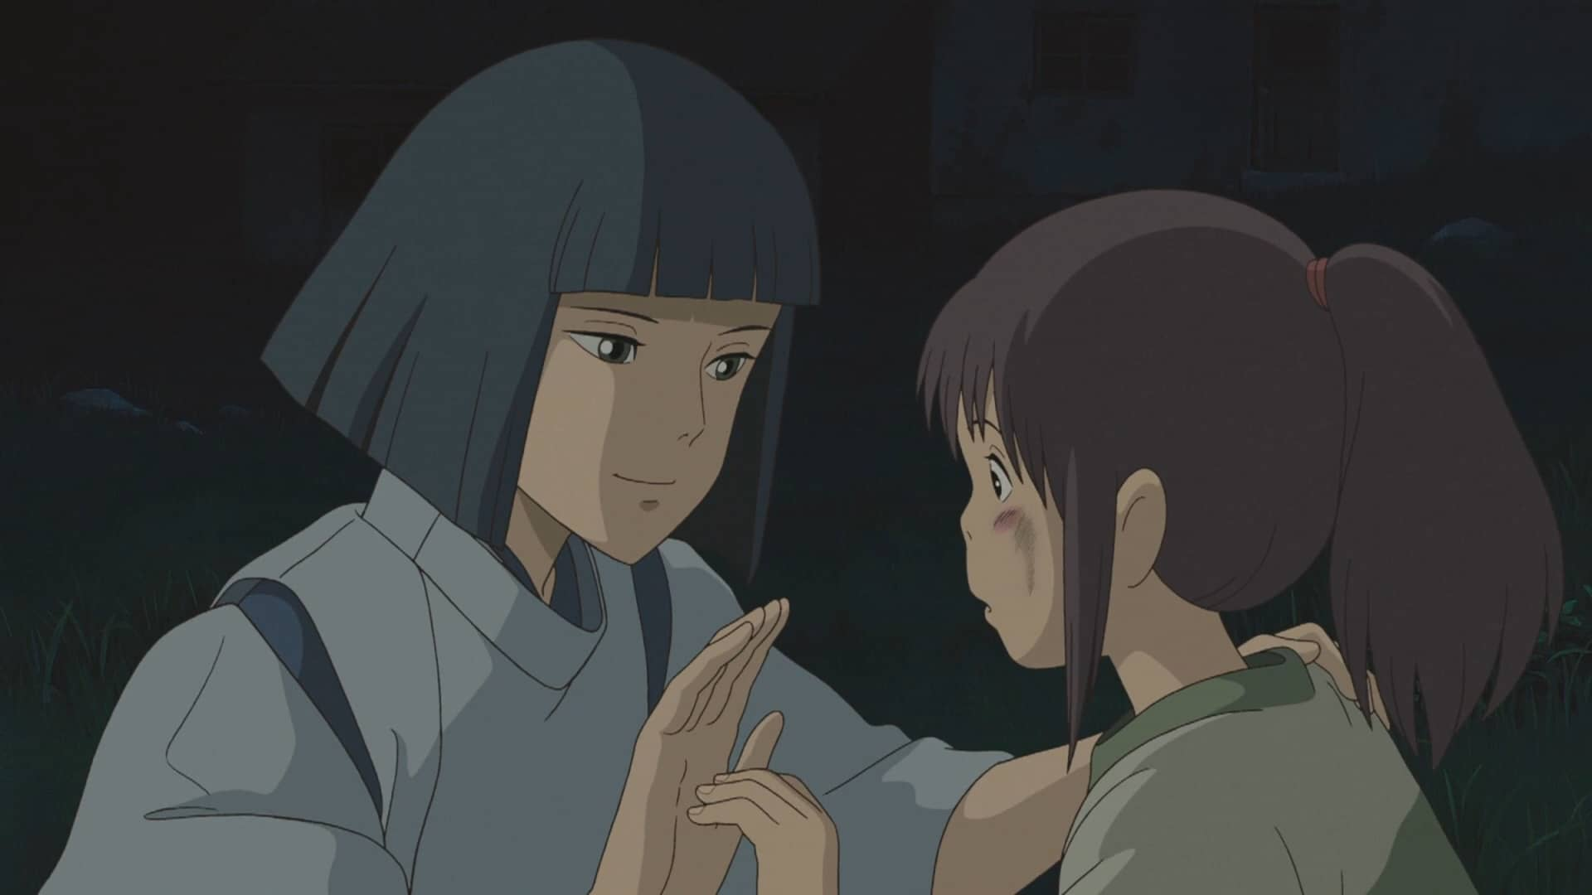
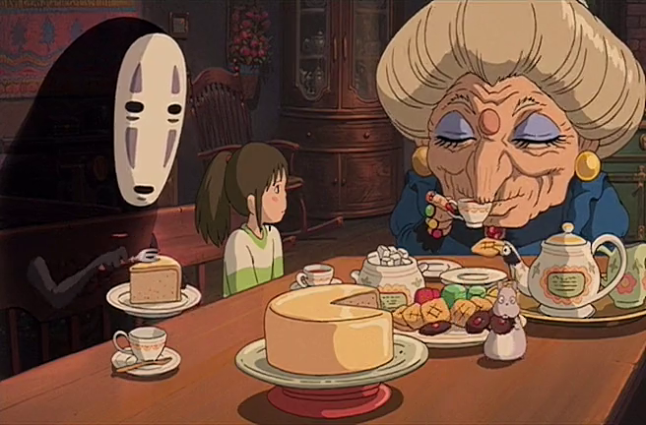

Slide 19
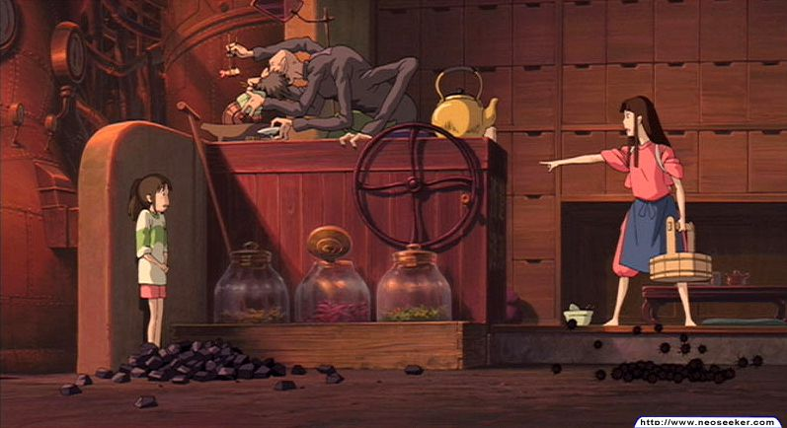
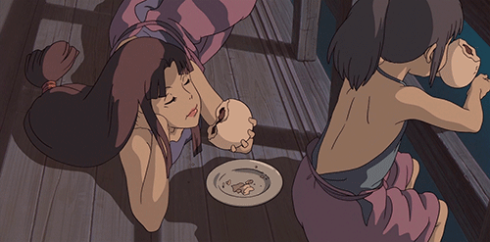
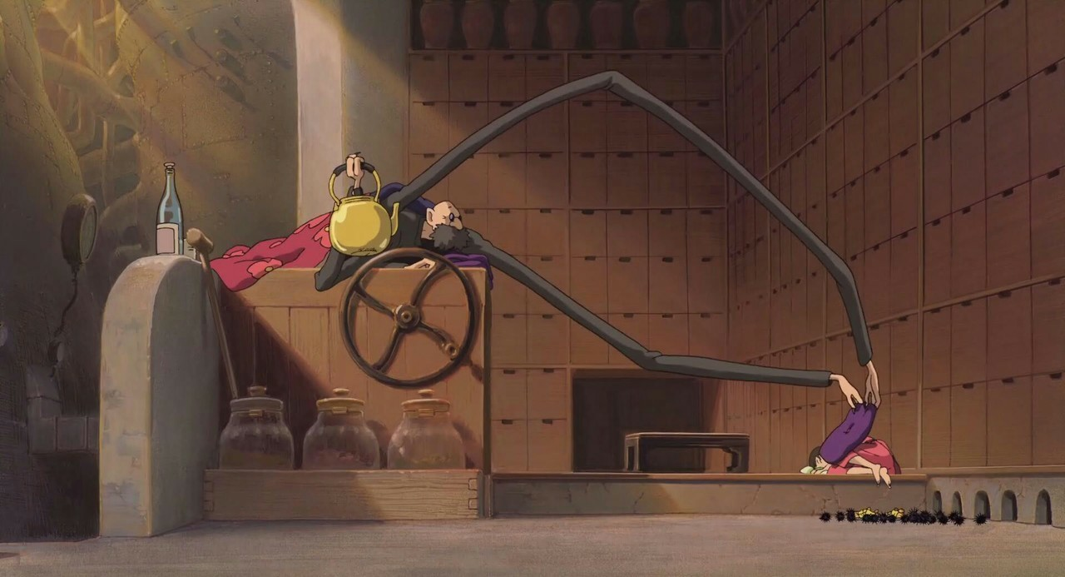

Slide 20
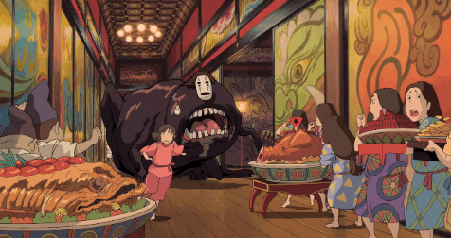
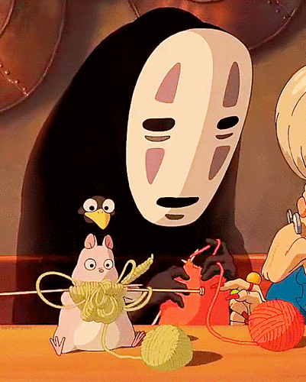
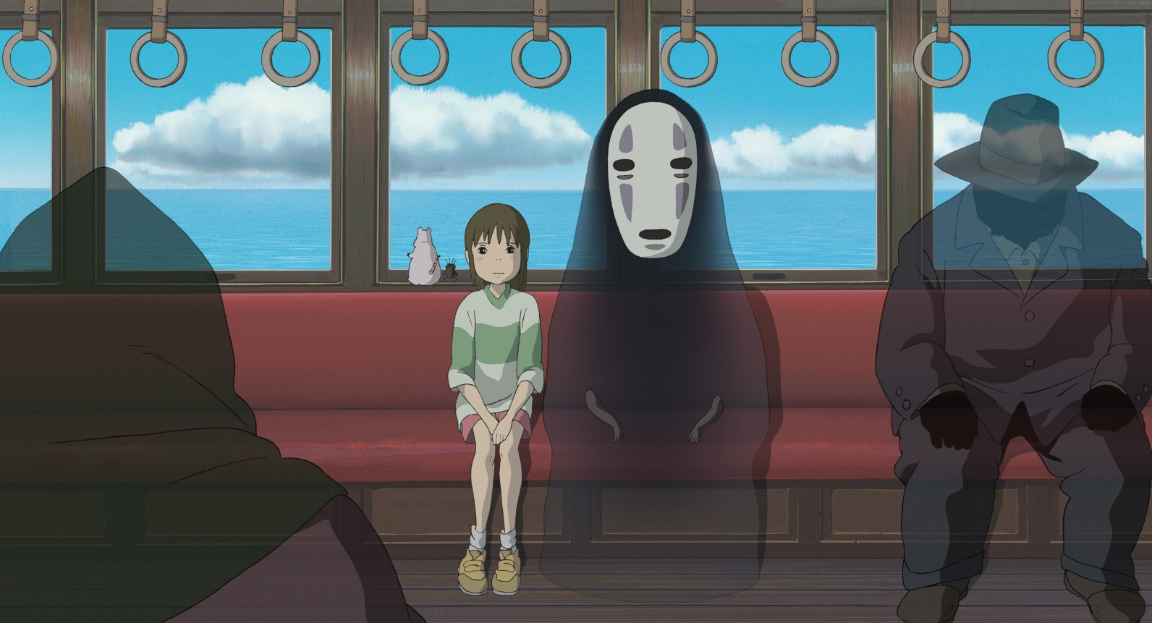

Slide 21
Shinto, Sacred Spaces, and Spirits
Demarcated Sacred Space

Slide 22
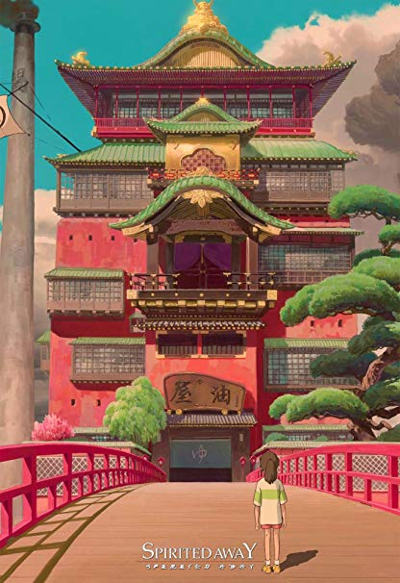
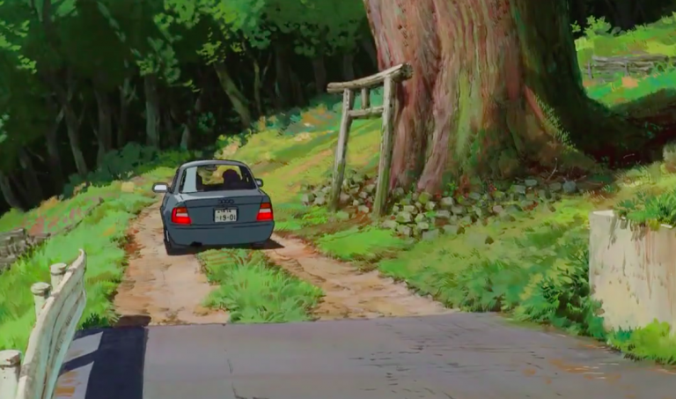

Slide 23
Animating Personality
Miyazaki’s Secret (the following slides contain GIFs of the ways Miyazaki animates personality)

Slide 24
