Slide 1
Early Film History
1895-1939 (and a Brief Overview of The Golden Age)

Slide 2
Early Technologies
Scopes and Phones from 1877-1925

Slide 3
Early Devices and Combinations
Devices:
Phonograph (1877) – Sound through vibrations through the etchings of a a rotating disc
Cinematograph (1890) – Invented by the Lumière Brothers
Kinetoscope (1891) – Designed for films to be viewed by one individual at a time

Slide 4
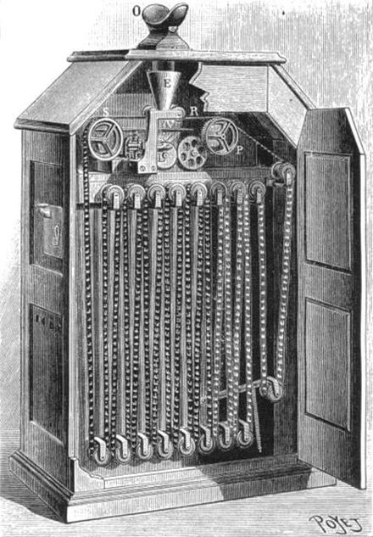
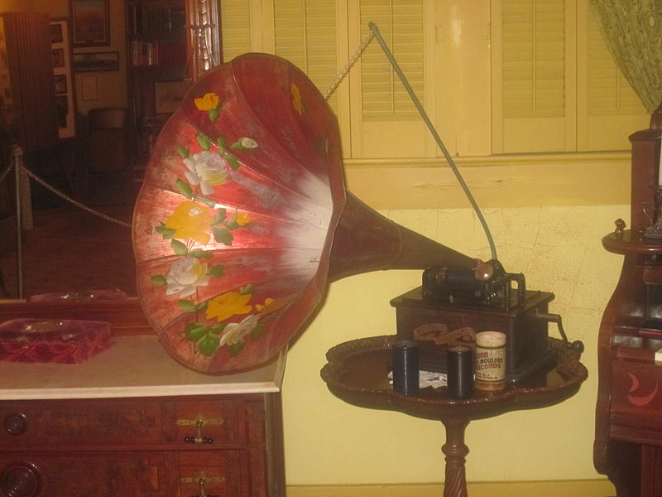
Phonograph (Thomas Edison, 1877)
Kinetoscope (Thomas Edison, 1891)

Slide 5
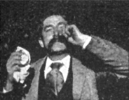
Kinetoscope – Fred Ott’s Sneeze (1894, first film with a copyright)

Slide 6
Early Devices and Combinations
Devices:
Phonograph (1877) – Sound through vibrations through the etchings of a a rotating disc
Cinematograph (1890) – Invented by the Lumière Brothers
Kinetoscope (1891) – Designed for films to be viewed by one individual at a time
Kinetophone (1895) – Essentially, the first cinema device that combined film with sound

Slide 7
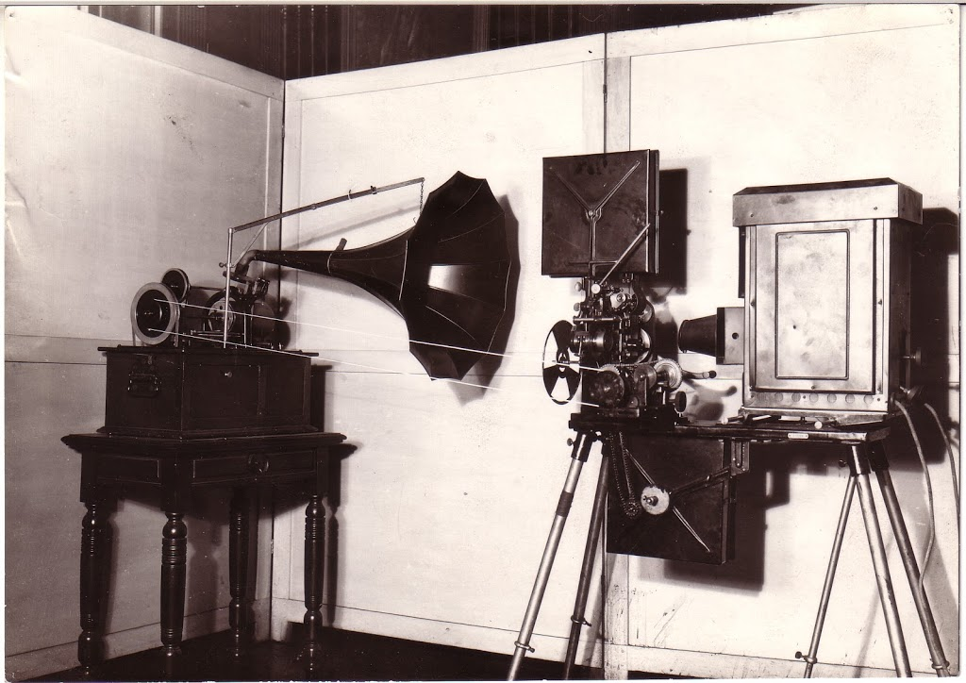

Slide 8
Early Film
The 1895 Dickson Experimental Sound Film
Featured two men dancing while Dickson played the violin into a recording horn, and one other man walks across the screen in the background from left to right
Kinetophone – developed by William Dickson and Thomas Edison
The Kinetophone is made up of a Kinetoscope and a phonograph (both Edison inventions)
Not a true sound film system; no synchronization of the sound and image

Slide 9
The 1895 Dickson Experimental Sound Film

Slide 10
Early Devices and Combinations
Devices:
Phonograph (1877) – Sound through vibrations through the etchings of a a rotating disc
Cinematograph (1890) – Invented by the Lumière Brothers
Kinetoscope (1891) – Designed for films to be viewed by one individual at a time
Kinetophone (1895) – Essentially, the first cinema device that combined film with sound
Chronophone (1902)
Vivaphone (1902)
Etc. Etc. Etc.
Vitaphone (1925); purchased by small studio Warner Brothers
The Jazz Singer, 1927 – sound-on-disc technology

Slide 11
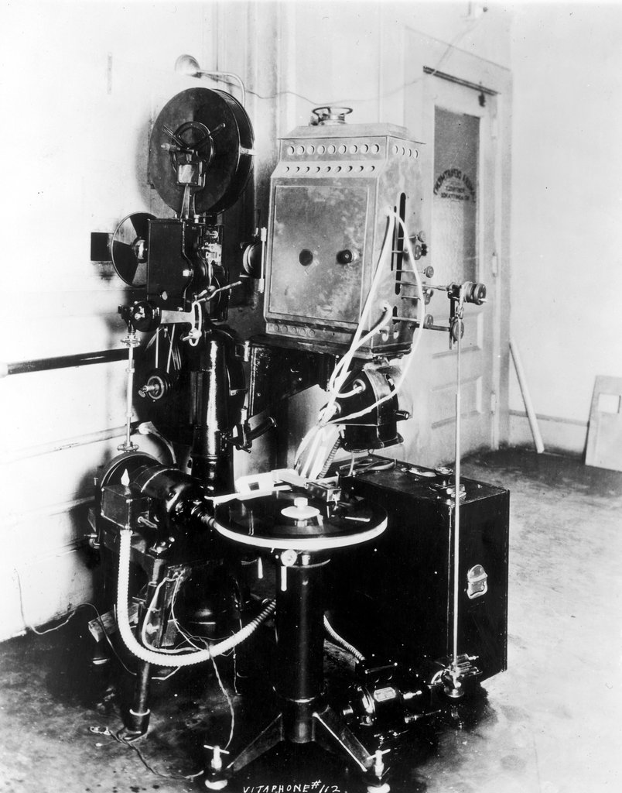
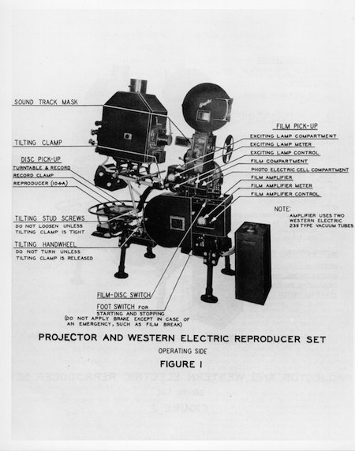

Slide 12
The Silent Era
1895-1927

Slide 13
Silent Film Era (1895-1927)
The era of film where films with no synchronous recorded sound, like dialogue, were produced
Plot and dialogue were conveyed with title cards with text, and acting was very expressive and gestural
Silent films were almost always accompanied by live sounds in theaters, ranging from piano accompaniment to orchestral scores
Silent films were made after 1927, though once sound film, or “talkies,” were developed, audiences mostly just wanted them

Slide 14
The Lumière Brothers
Two of the earliest filmmakers; together they made a series of films in 1895 and toured around the world with their invention, the cinematograph
Most notable films:
L'Arrivée d'un train en gare de La Ciotat (The Arrival of a Train at La Ciotat Station) - 1895
Le Jardinier (The Gardener) - 1895
La Sortie de l'usine Lumière à Lyon (The Exit from the Lumière Factory in Lyon) - 1895

Slide 15
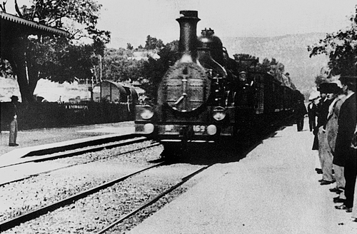
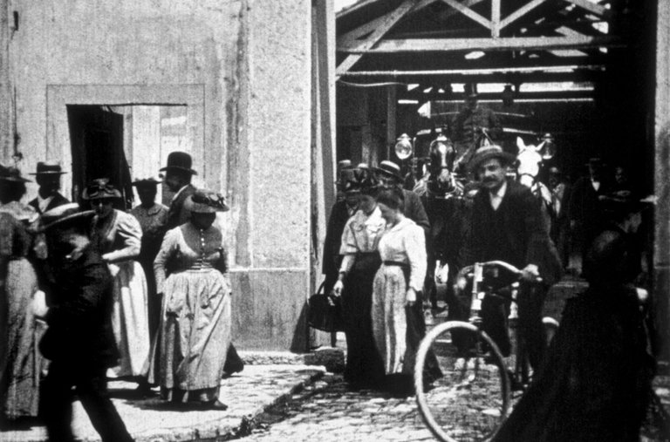
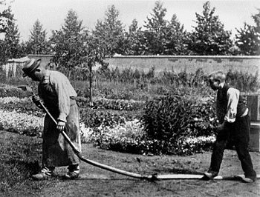

Slide 16
Georges Méliès
Early 1900s filmmaker who depicted surreal journeys through early special effects:
Substitution splices
Multiple exposures
Time-lapse
Dissolves
Hand-painted coloring
Most famous works:
A Trip to the Moon (1902)
The Impossible Voyage (1904)

Slide 17
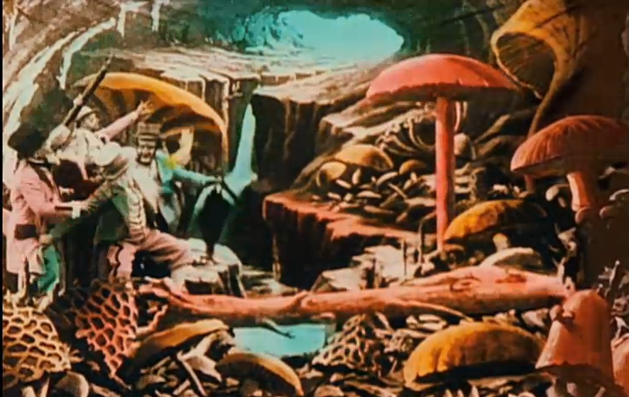
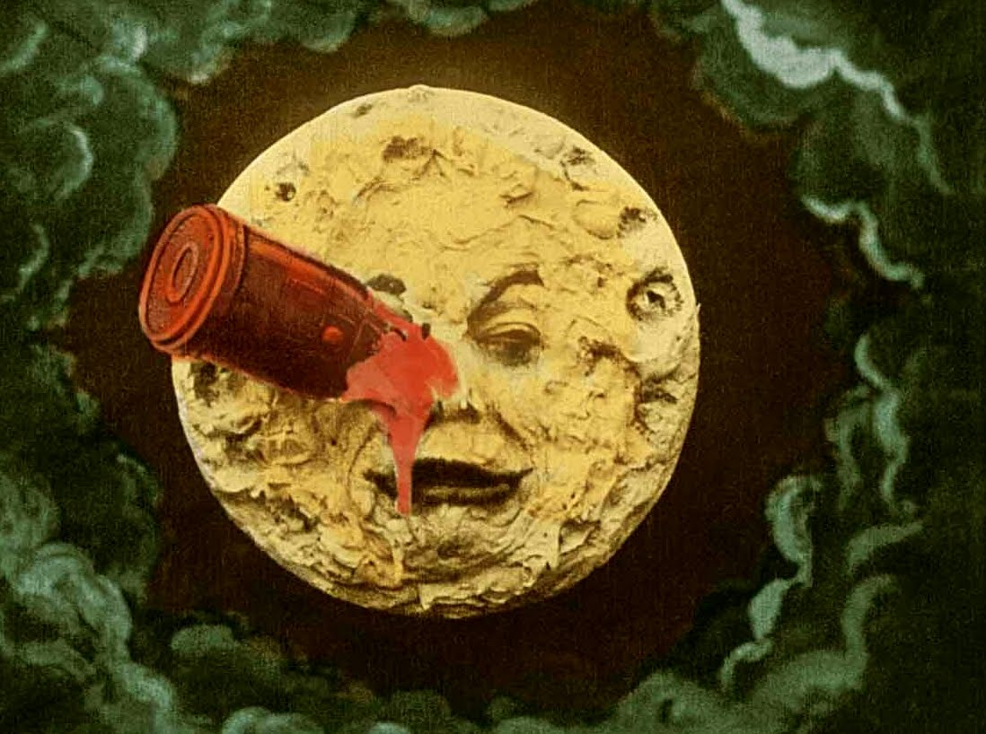
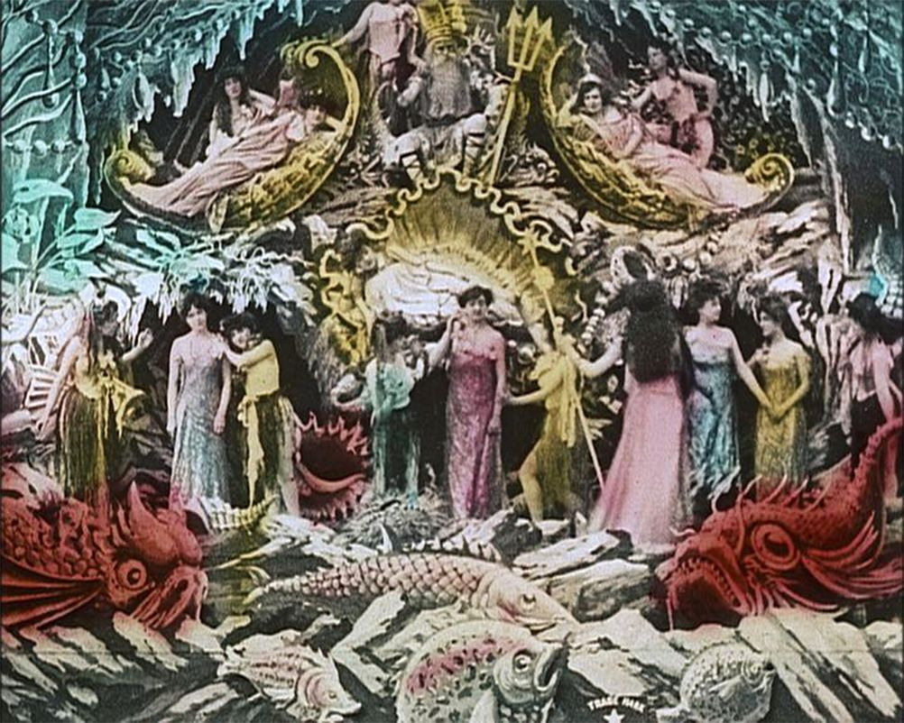

Slide 18
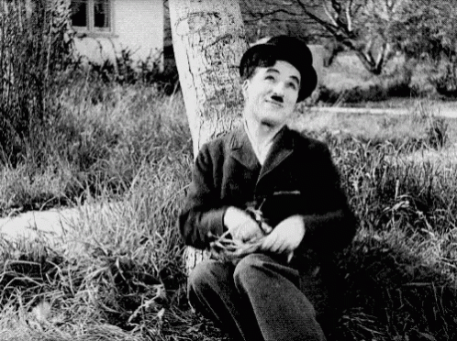
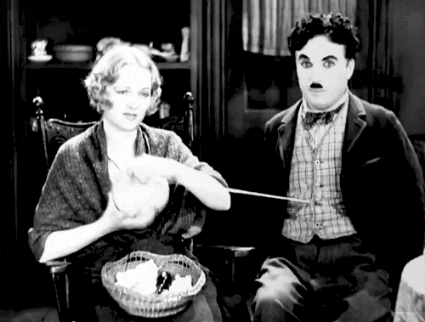
Charlie Chaplin

Slide 19
Russian Formalism
Kuleshov and Eisenstein

Slide 20
Formalists and Montage
Formalism considers the synthesis of the formal elements of filmmaking, such as lighting, scoring, sound, set design, and editing
Making a science of the formal elements of the moving picture
Major figures:
Lev Kuleshov (montage)
Sergei Eisenstein (montage, matching editing, editing techniques)
Vsevelod Pudovkin
Béla Balázs

Slide 22
Eisenstein’s Lions from Battleship Potemkin (1925)
https://www.youtube.com/watch?v=sChr6jm7Ntw

Slide 23
Battleship Potemkin’s Odessa Steps Sequence
Montage and Matching Ediding

Slide 24
Odessa Steps
https://youtu.be/4xP-8r7tygo?t=267

Slide 25
German Expressionism
Early Filmmaking Techniques of the 1920s

Slide 26
German Expressionism and German Expressionists
The term “German Expressionism” refers to a number of related creative movements (across art, painting, architecture, dance, sculpture, and cinema) that spanned from before WWI through the early 1930s, reaching a peak in the early to mid-20s
In 1916, due to Germany’s isolation in WWI, the government banned all foreign films, leading to a dramatic increase in films produced in Germany
In 1914, Germany produced 24 films
In 1918, Germany produced 130 films

Slide 27
German Expressionism and German Expressionists
The German Expressionism cinema movement is characterized by:
Surreal architecture, with buildings that have sharp angles and jagged lines in the set design, great heights, and crowded environments
Rejections of naturalistic depictions of objective reality, leading to distorted figures, buildings, and landscapes that feel unnatural and unguided by the laws of physics
Jagged, harsh, stylized shapes and unnatural colors were used to convey subjective emotions
Cultural and political notions arising in the art
Filmmakers:
F. W. Murnau
Erich Pommer
Robert Wiene
Fritz Lang

Slide 28
Most Notable German Expressionist Films
The Student of Prague (1913)
The Cabinet of Dr. Caligari (1920)
From Morn to Midnight (1920)
The Golem: How He Came into the World (1920)
Destiny (1921)
Nosferatu (1922)
Phantom (1922)
Schatten (1923)
Metropolis (1927)
M (1931)

Slide 29
Images and Gifs from German Expressionist Films

Slide 30
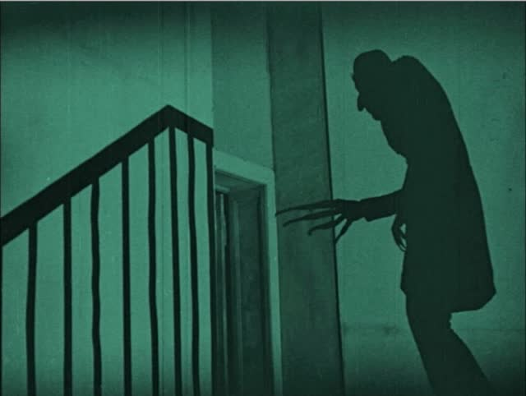
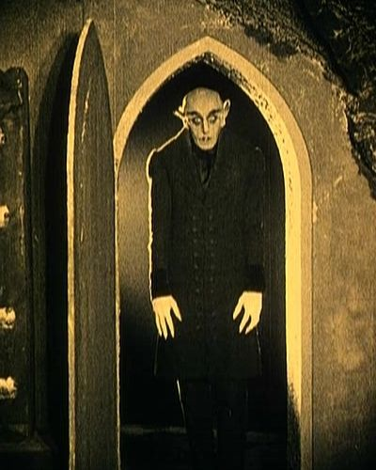

Slide 31
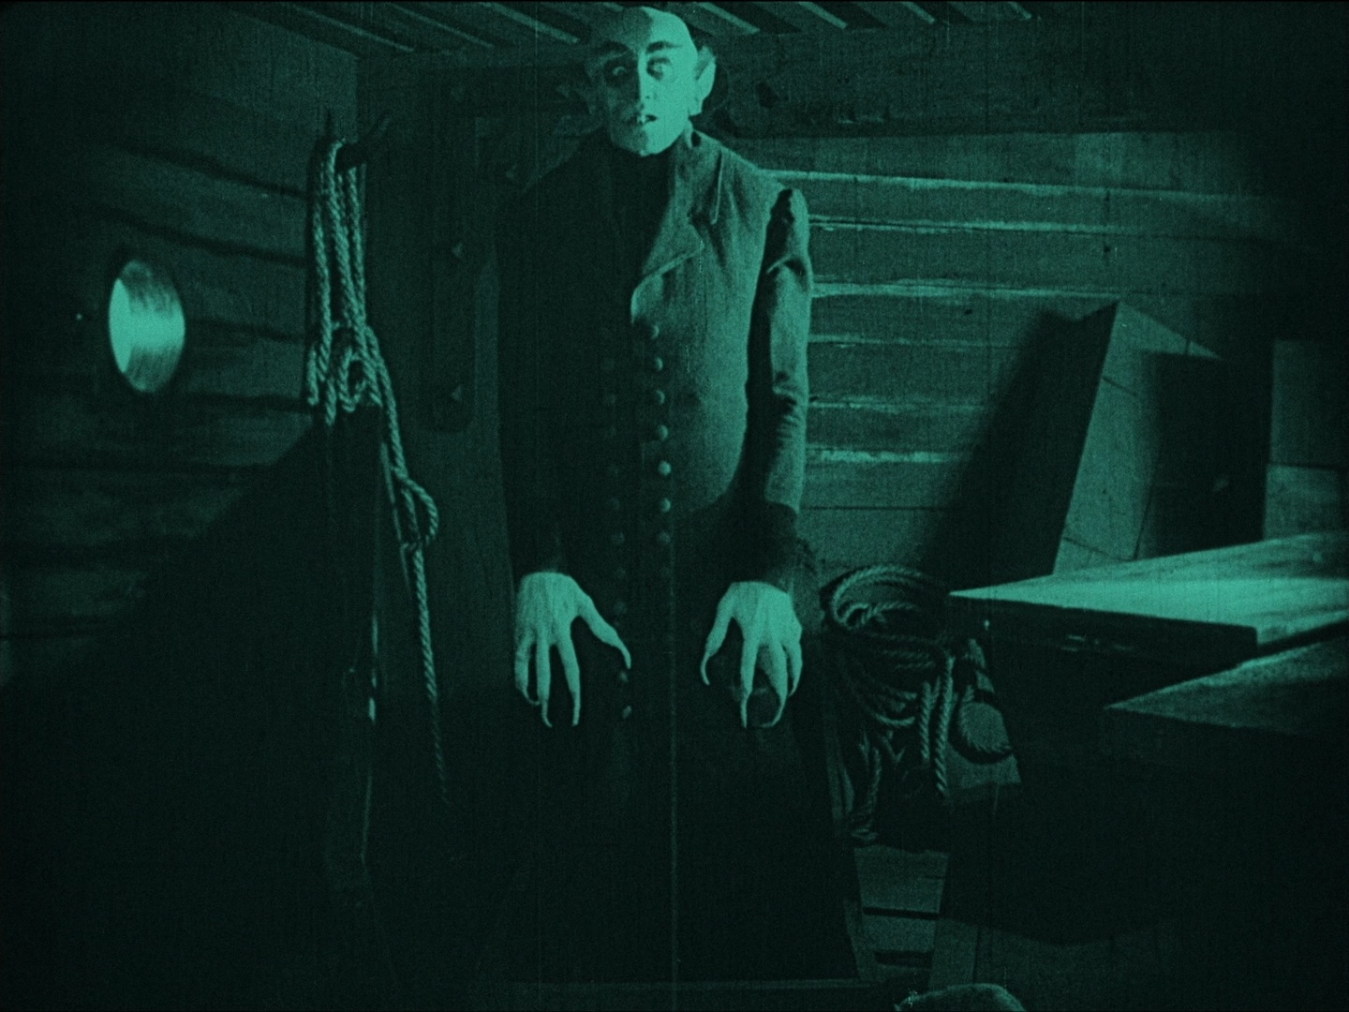

Slide 32
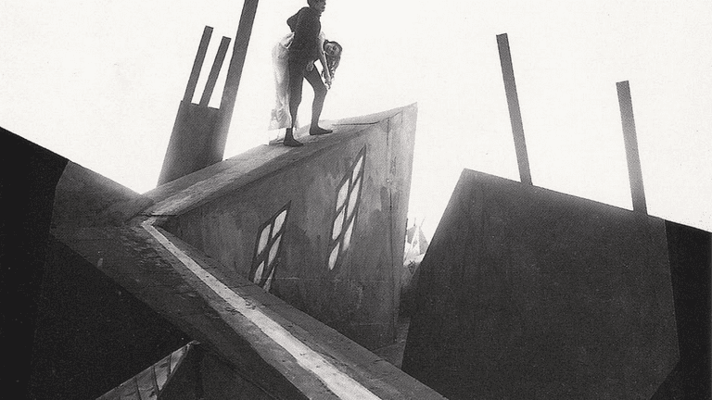
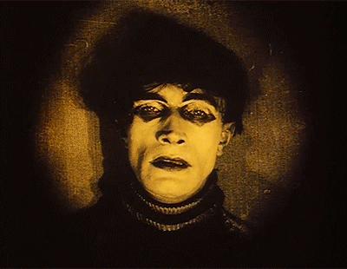

Slide 33
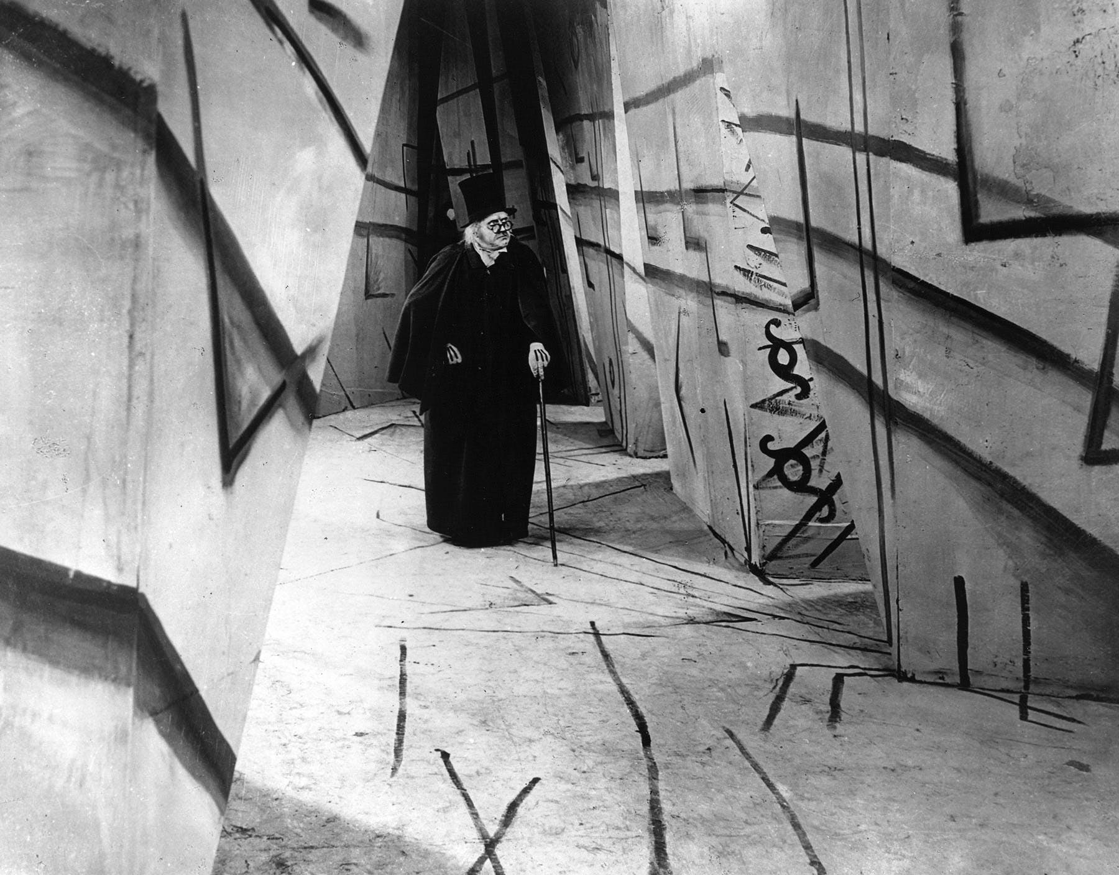

Slide 34
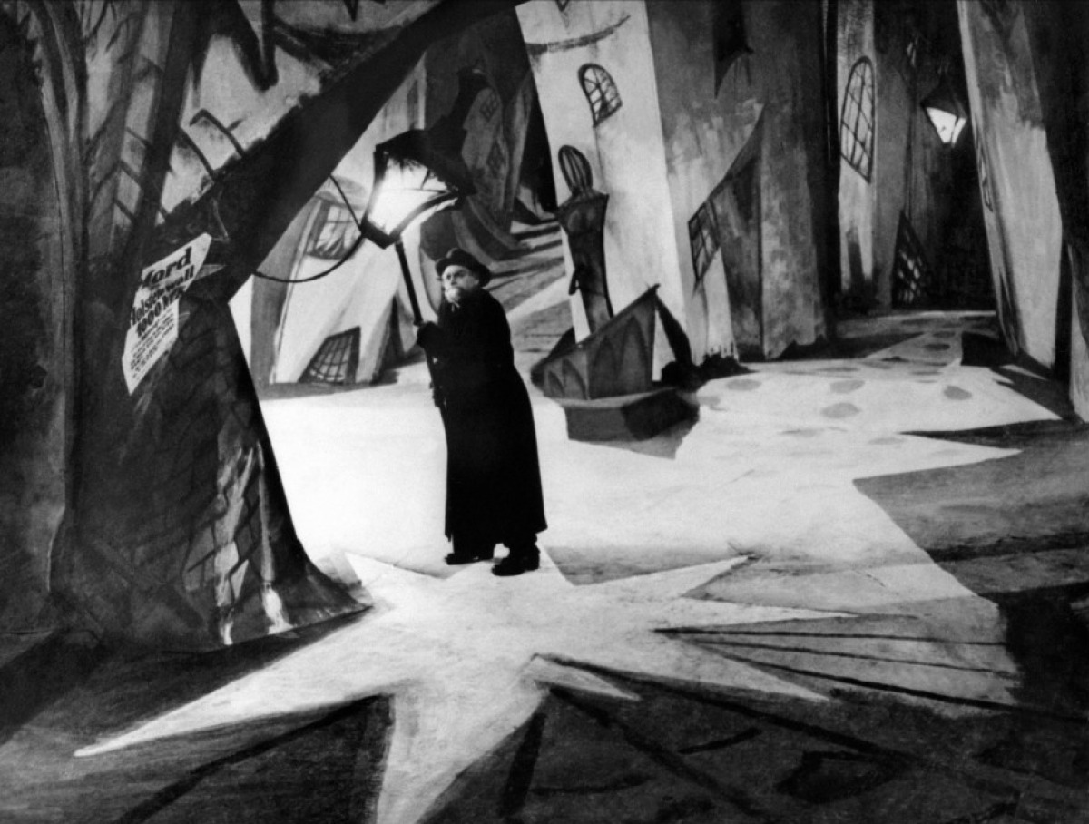

Slide 35
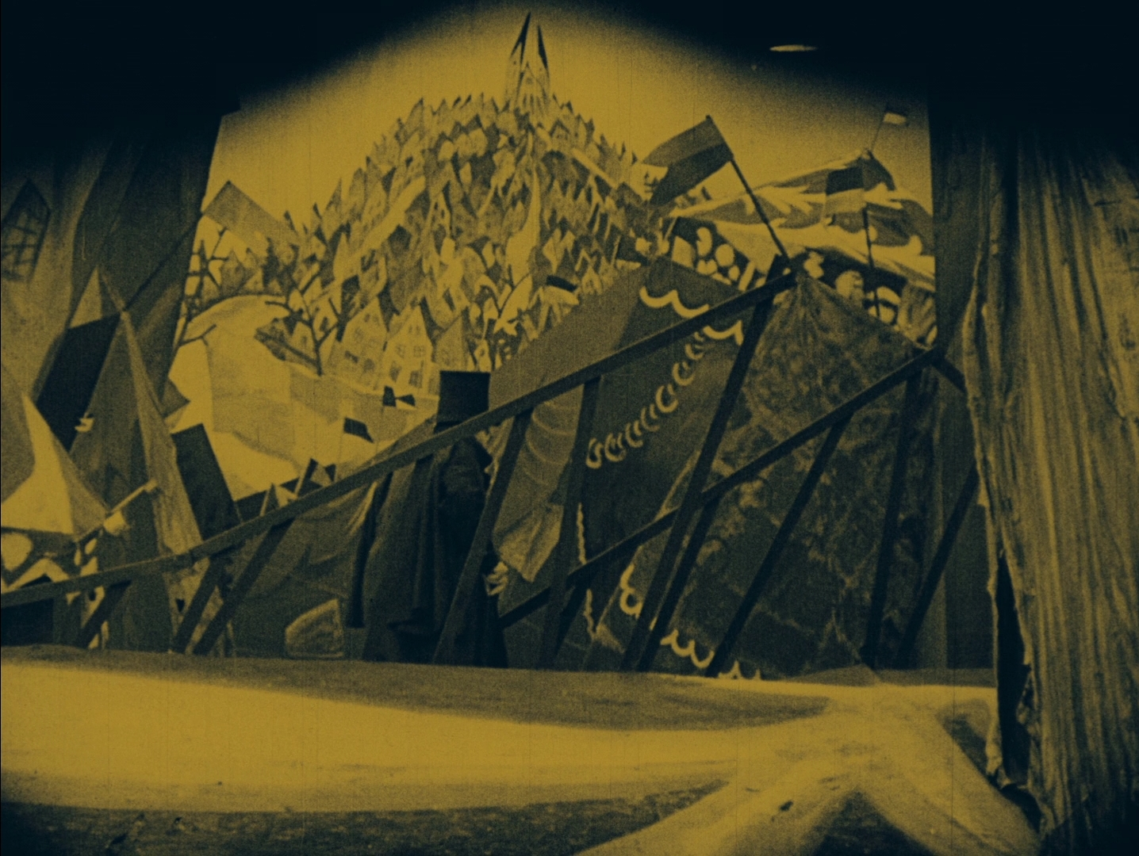

Slide 36
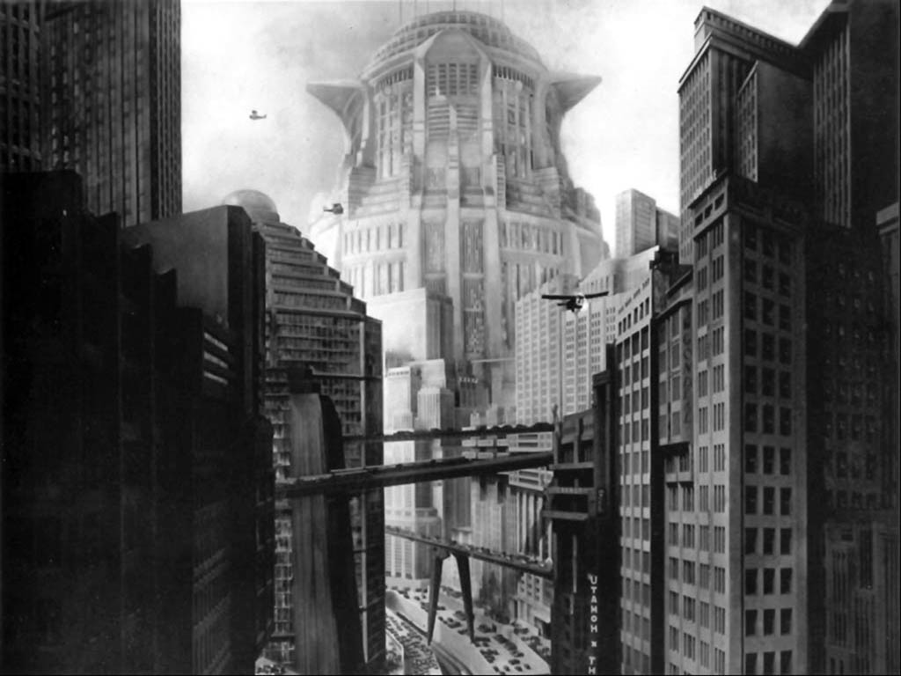

Slide 37
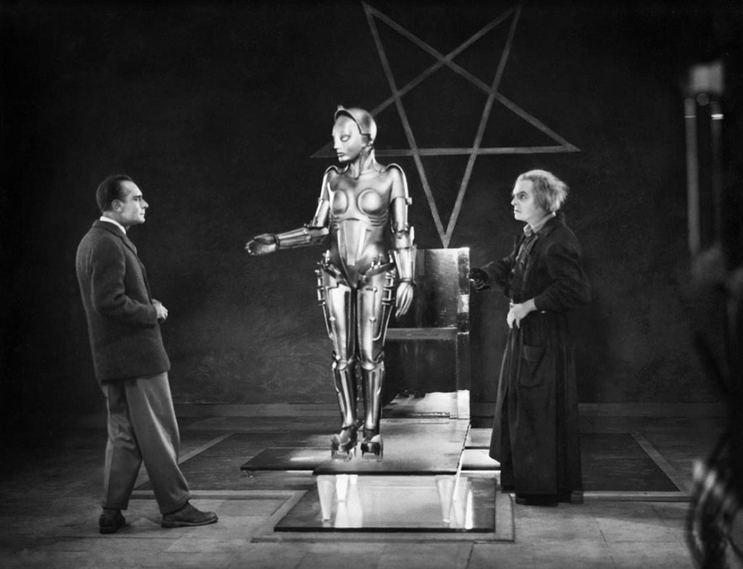

Slide 38
The Golden Age of Hollywood
1939-1948

Slide 39
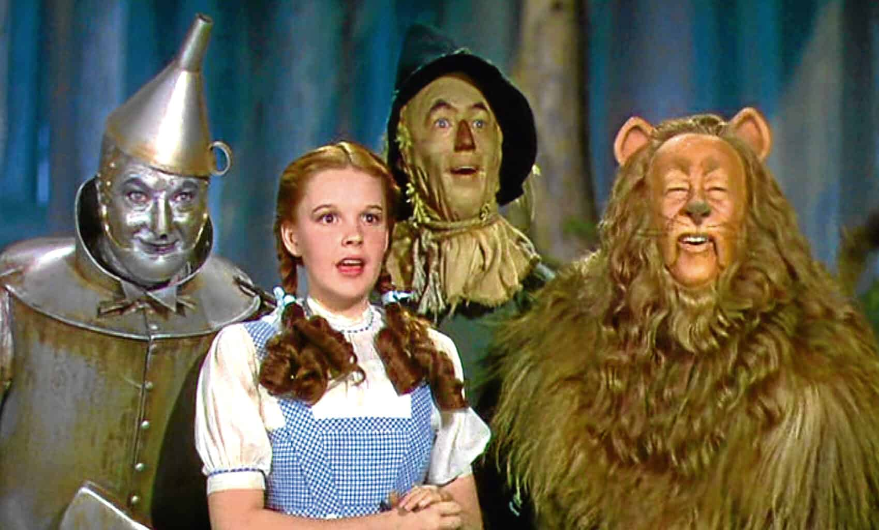
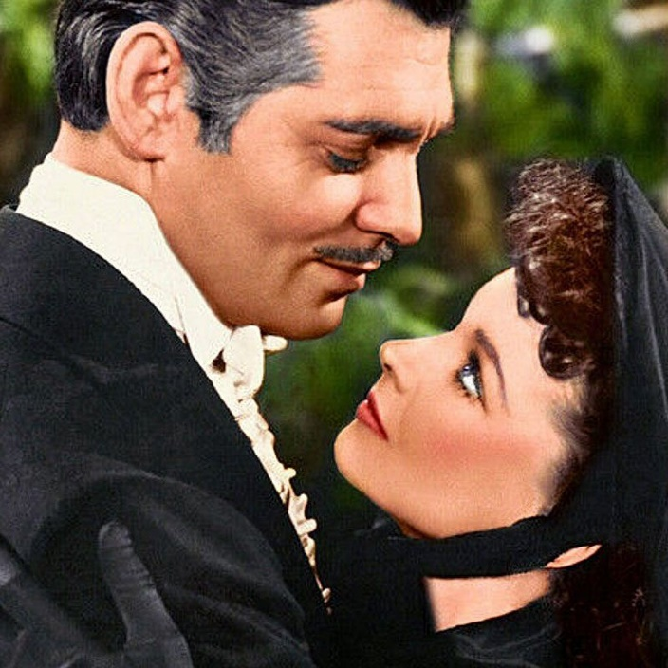
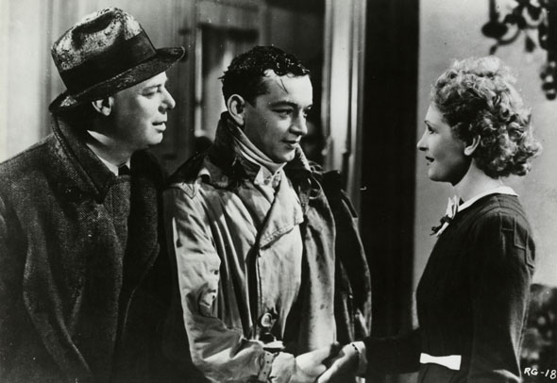
1939 – The Best Year in Film History
The Wizard of Oz
Stagecoach
Gone with the Wind
Wuthering Heights
Of Mice and Men
Ninotchka
La Regle du Jeu (The Rules of the Game)
The Hunchback of Notre Dame
Mr. Smith Goes to Washington
Dark Victory
Gulliver’s Travels
The Adventures of Huckleberry Finn

Slide 40
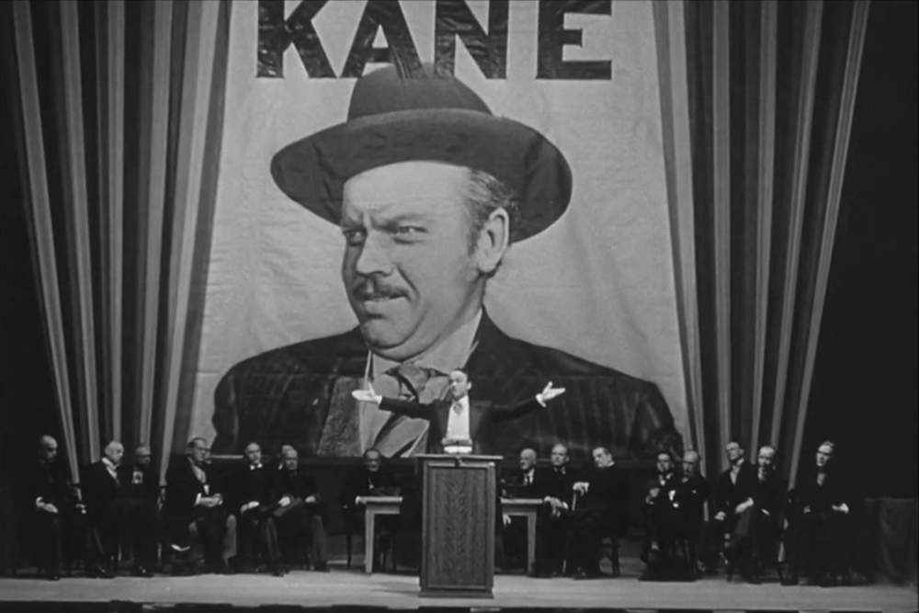
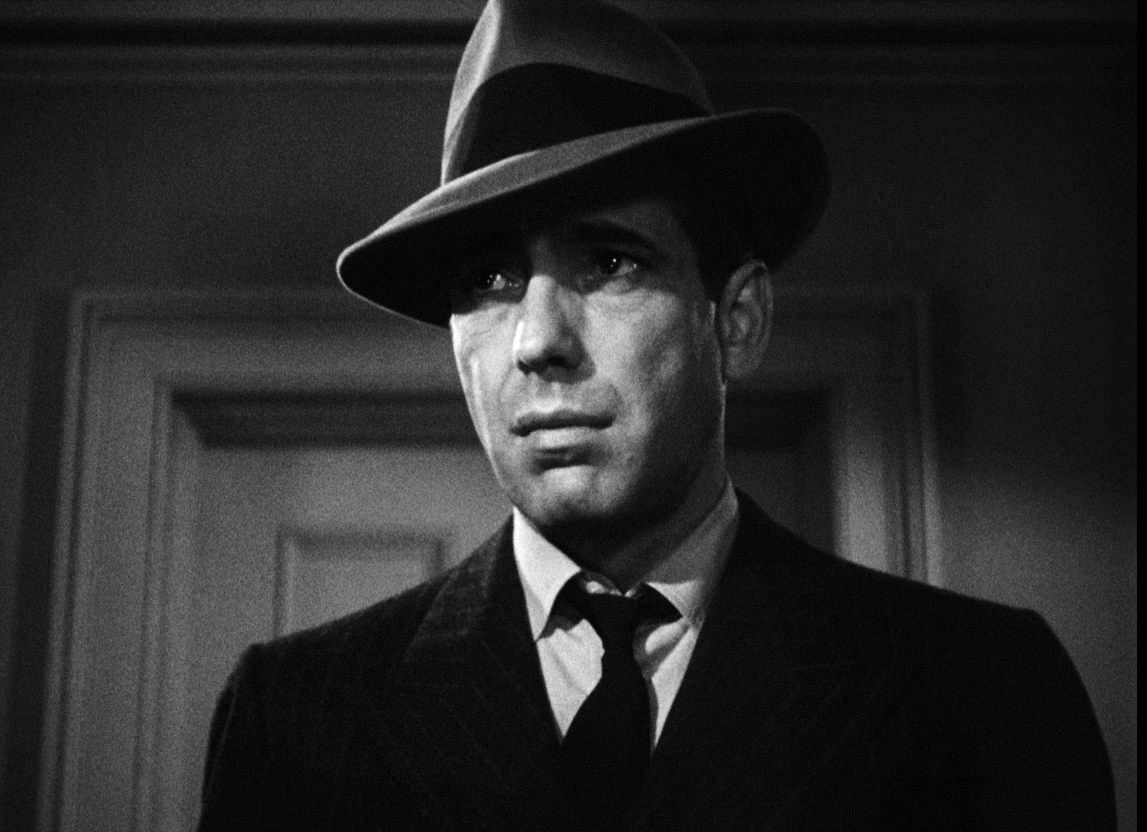
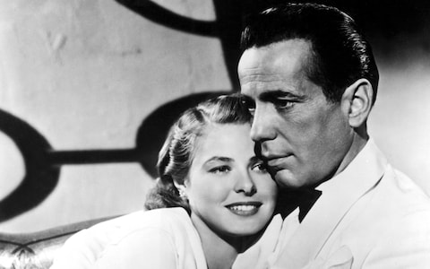
Golden 1940s
The Philadelphia Story (1940)
The Grapes of Wrath (1940)
The Great Dictator (1940)
Pinocchio (1940)
Fantasia (1940)
Citizen Kane (1941)
The Maltese Falcon (1941)
Casablanca (1942)
Double Indemnity (1944)
Mildred Pierce (1945)
The Big Sleep (1946)
It’s a Wonderful Life (1946)
The Treasure of the Sierra Madre (1948)
The Third Man (1949)

Slide 41
The End of the Golden Age
Three major factors to the end of the Golden Age:
The rise of the television in private homes in the 50s
American families movement away from urban spaces and towards rural ones
The collapse of the Hollywood studio system

