Slide 1
Can Images Argue?

Slide 2
Are Letters Images?
Can they argue anything separately? What is the difference between letters, words, and images?

Slide 3
A

Slide 4
Apple

Slide 5
Apple

Slide 7
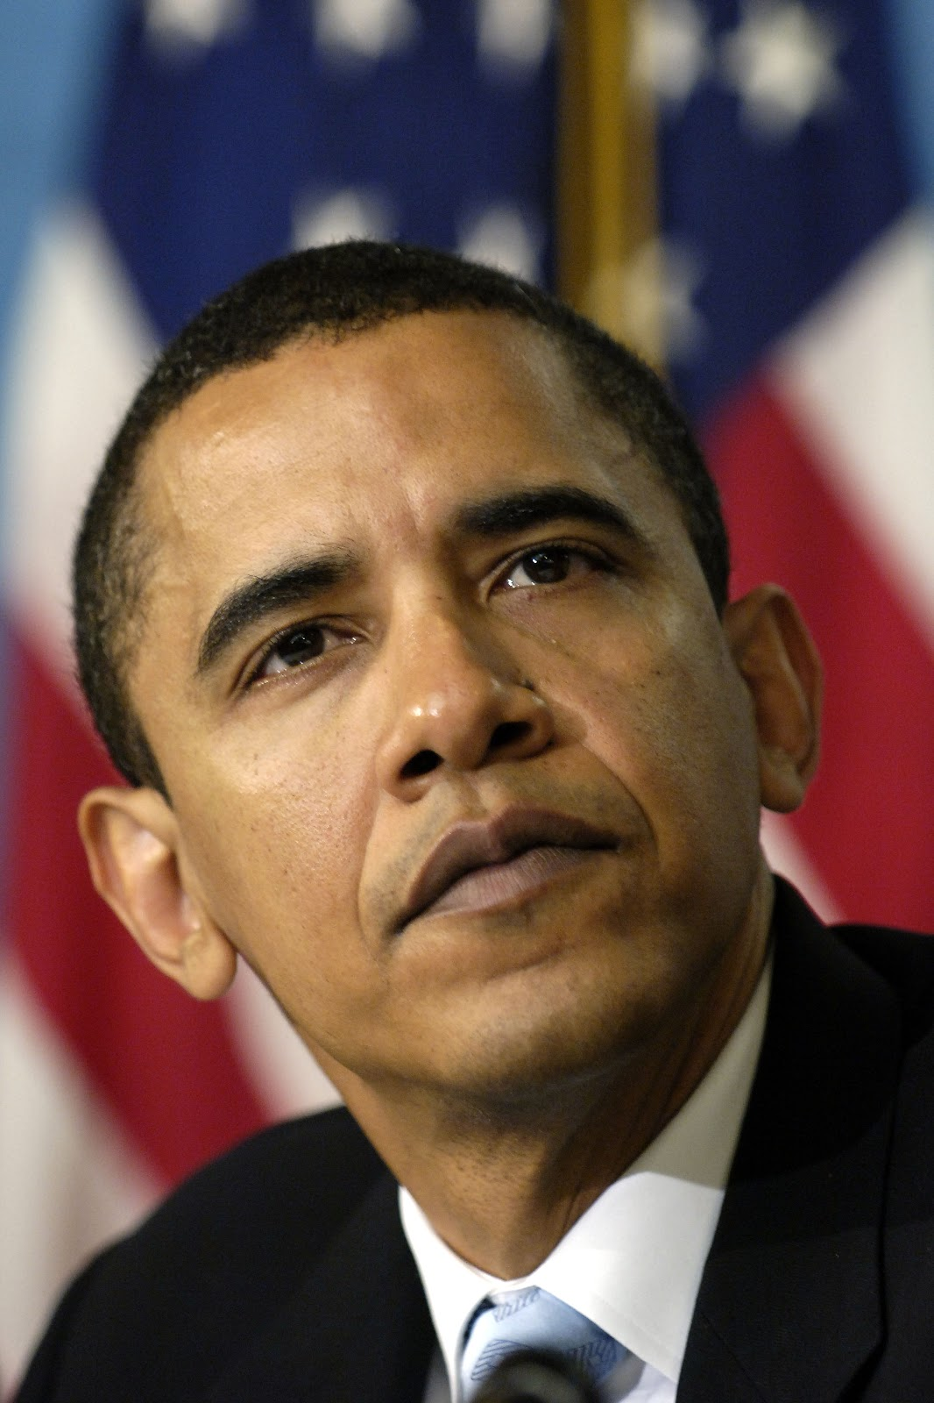

Slide 8
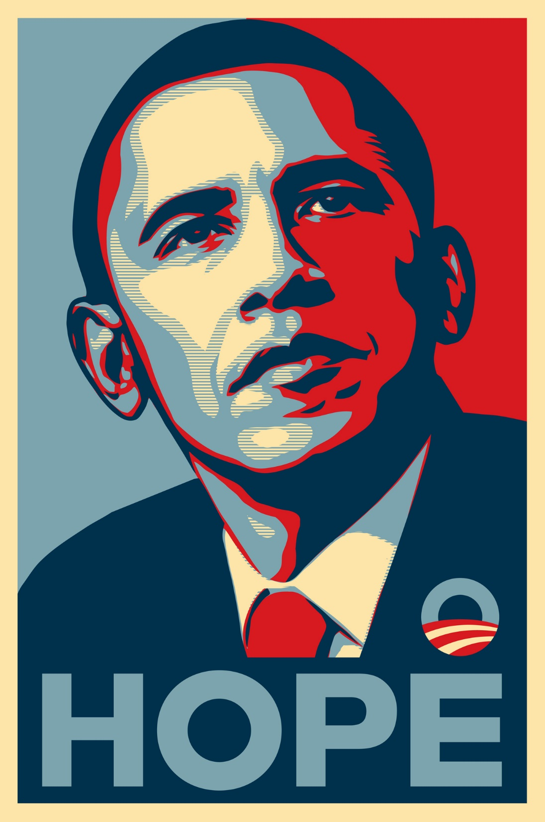

Slide 9
Can Images Make an Argument without Words?
Symbols, Icons, Allusion, Metaphors

Slide 10
The Model and the Painting (1926) by K. A. Suvanto, Published in The Daily Worker
A Chicago/New York communist newspaper that ran from 1924-1958

Slide 11
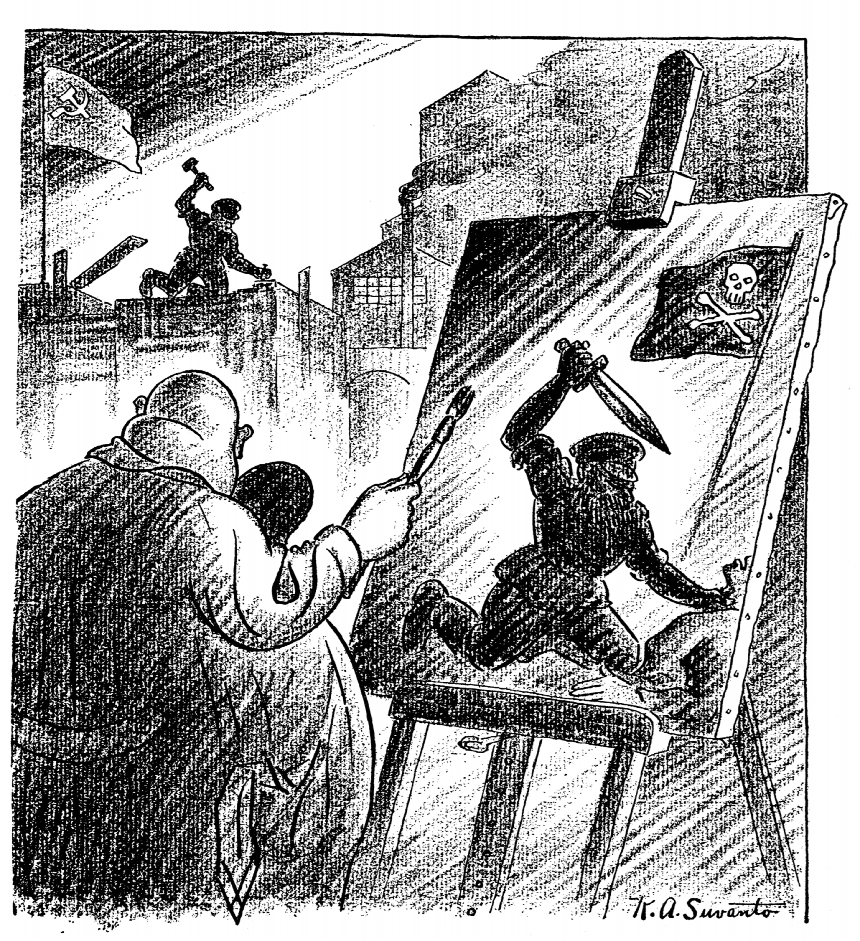

Slide 12
Before Moving to the Next Slide…
Make a list of the things you can observe in the image; what kind of image is this? Who are the people depicted in the image and what are their physical qualities? What are the people doing in the image? What objects are depicted in the image?
Next make a list of what you think is happening in the image; how are these people and what they are doing meaningful? Is there an argument you can identify? Take a guess or two about what the argument might be.

Slide 13
Observations
In background we see the flag of the former Soviet Union—hammer and sickle and the silhouette of a communist worker
The sky suggests dawn (“red dawn”); the new building in construction suggests the new industrial communist society
In the foreground, we see a painter with exaggerated obesity, a suit and a bald head—standard symbols of a wealthy capitalist
The painting is meant to be of what he sees in the background but instead his painting bears little resemblance to what we see in the actual background; the hammer and sickle (symbols of work) are replaced by a skull and crossbones; the hammer becomes a dagger which the worker (now a ruthless soldier) plunges into his victim

Slide 14
How do your observations match up with these?
Were you able to identify the communist hammer and sickle symbol? Were you able to recognize that there is a difference between what the painter sees and what he puts onto his canvas? Were you able to identify what the painter represents?
Everyone will have different observations based on their own cultural knowledge and also based on the amount of time and care taken when examining the image. We all bring to images our own baggage and that context shapes how we feel the image is communicating. Yet some elements about the image are clear and not necessarily subjective; there is a specific argument being made.

Slide 15
Argument
Soviet communism is hard at work building a new industrial society; greedy, self-interested, capitalist commentators distort the facts, portraying the Soviets as violent and repressed; concluding that we should not listen to those who attack the new Soviet experiment

